Slide 1

Services Presentation
https://www.tamago.cx
June 2025
Version 1.0

Slide 2


CX Solutions (Customer Service)
CX solutions are strategies, technologies, and practices aimed at improving the customer experience at all touchpoints with the company — from the first website visit to after-sales. Customers may be suppliers or even internal, such as employees served by the HR department, contacted by the tech team, or the sales force supported by the company.
Pains
Low customer retention
High churn (cancelation) taxes
Negative brand reputation
Lack of integrated customer view
Benefits
1. Increased customer satisfaction and loyalty
2. Reduced churn and increased LTV (life time value)
3. Improved reputation and NPS (net promoter score)
4. Greater operational efficiency through automation and personalization
5. Revenue growth through more effective upsell and cross-sell.
How Tamago can help your company
1. Omnichannel service platforms (chat, e-mail, social media)
2. Feedback and sentiment analysis tools
3. 360º customer view
4. Artificial Inteligence for personal journeys, self-service, automation and productivity improvement
Main partners

Slide 3


CX Solutions (Personalized Shopping Experience)
These are technologies that allow you to adapt, in real time, each customer’s experience based on their behavior, preferences, and purchase history — creating unique and relevant journeys across all channels (web, app, e-mail, physical store, etc.).
Pains
Generic and irrelevant customer experience
Low conversion rates and cart abandonment
Difficulty activating all customer segments
Channel misalignment
Benefits
1. Increased conversion and average ticket size
2. Reduced cart abandonment
3. Improved customer loyalty and retention
4. Seamless and consistent experience across all channels.
How Tamago can help your company
1. Predictive recommendations based on behavior and purchase history
2. Personalization from the first visit, even for anonymous users
3. Dynamic segmentation based on location, weather, device, and more
4. Event-triggered messages (e.g., cart abandonment, product browsing)
5. A/B testing and continuous optimization to validate what works best
6. Integration with Mastercard consumption data to forecast future behavior
Main partners

Slide 4




E-Commerce
E-commerce platforms are technological solutions that allow the creation, management, and scaling of online stores. They support everything from website development to product management, payments, logistics, and digital marketing.
Pains
Difficulty launching and scaling a digital sales channel
2. Lack of integration across channels (online, physical, marketplaces)
3. Inconsistent shopping experiences
4. Low flexibility to personalize the customer journey
5. High costs for maintaining legacy systems
Benefits
1. MACH Architecture (Microservices, API-first, Cloud-native, Headless)
2. Full freedom for customization and integration with any system
3. Scalability with cloud-agnostic global infrastructure
4. Unified omnichannel experiences
5. Lower total cost of ownership (TCO) in the long term
6. Reduced vendor dependency (vendor lock-in)
How Tamago can help your company
1. Development of virtual stores and mastery of all stages of the process
2. Multichannel sales (website, social media, marketplaces, physical stores)
3. Digital marketing tools and SEO
4. Fast or fully customized implementations (headless commerce)
5. Scalability, from small shops to enterprise-level
6. Varied operating models: Retail, D2C, B2B, B2C, and Marketplaces.
Main partners

Slide 5
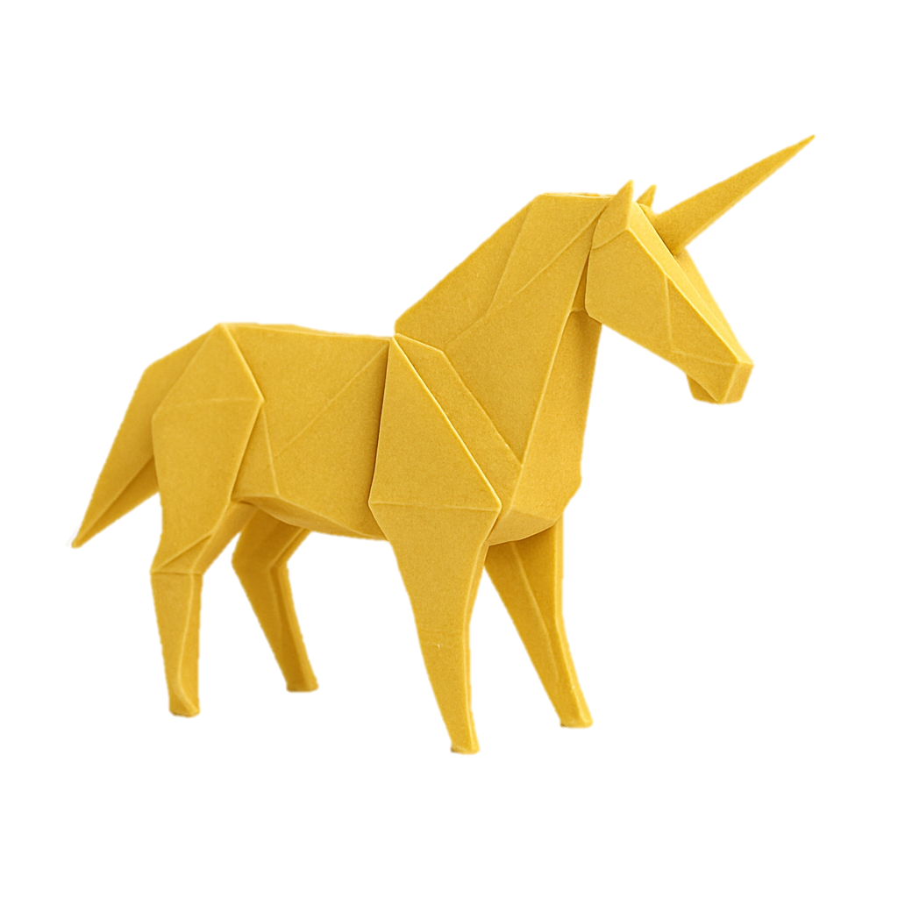



Innovation
Innovation is essential for companies to remain competitive and relevant. It helps reduce costs, automate processes, and deliver more efficient customer experiences. By adopting technologies like AI and no-code platforms, businesses gain agility and adaptability in the market.
Pains
Costs with repetitive manual tasks
2. Infrastructure costs control
3. Customized developments (tailor made)
4. Rapid developments
5. Problems with indoor or outdoor navigation
Benefits
1. Task automation using Artificial Intelligence Agents
2. Consulting for the implementation of FinOps initiatives
3. Development with Cloud, No-Code or Low-Code platforms
4. Complete solutions for Indoor and Outdoor navigation for task execution, maintenance, etc
How Tamago can help your company
Development of AI agents for various activities:
  Customer service
  Infrastructure task automation
  Content production
2. Traditional development, no-code/low-code, mobile and on cloud platforms;
3. Implementation of solutions for indoor/outdoor location and execution of tasks, maintenance, etc
Main partners

Slide 6
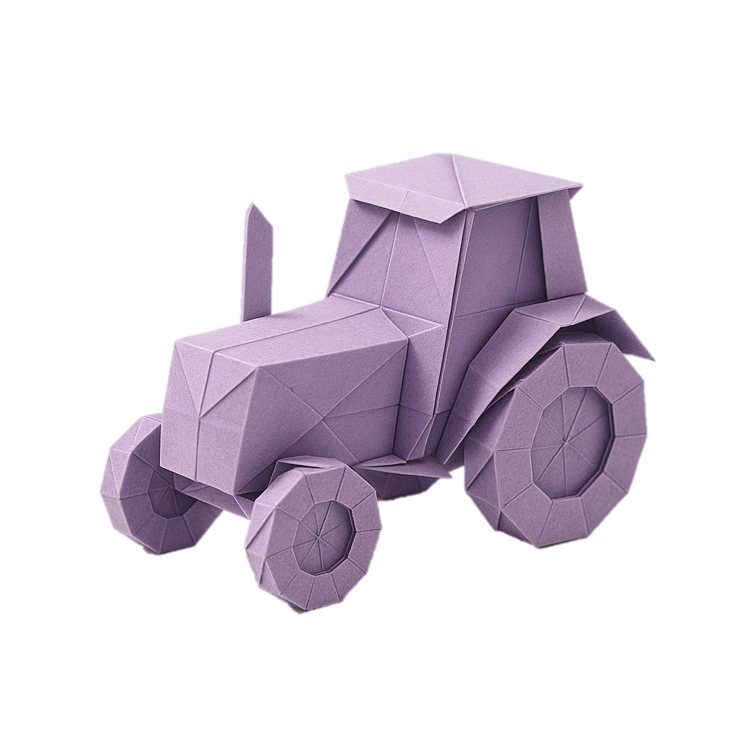

Agriculture Solutions
Integrated digital solutions that help agribusiness companies manage the entire agricultural production chain, from crop planning to commercialization — with a focus on efficiency, sustainability, and profitability.
Pains
1. Lack of visibility into agricultural operations
2. Inefficient resource management (land, water, inputs)
3. Challenges in traceability and regulatory compliance
4. Low integration across areas (field, logistics, finance)
Benefits
1. Smart agricultural planning based on historical data and climate forecasts
2. Integrated management of inputs, labor, and machinery
3. Full traceability from production to the consumer
4. Cost reduction through automation and real-time control
5. Scalable cloud platform, with remote access and mobility in the field
6. Specific solutions for livestock, grains, fruits, dairy, and more
How Tamago can help your company
1. Full consulting for implementation.
2. Integration with SAP S/4HANA for financial, logistics, and supply chain management (or other platforms)
3. Use of AI and analytics for agronomic recommendations and crop forecasting
4. Support for diverse business models: cooperatives, independent producers, agribusinesses
5. Scalable cloud platform, with remote access and mobility in the field
6. Specific solutions for livestock, grains, fruits, dairy, and more
Main partners

Slide 7



Thank you Obrigado ありがとう Hvala
Bruno Katayama
bruno.katayama@tamago.cx
June 2025

